Slide 1
PMCA502L – JAVA Programming
GUI and JDBC
GUI Programming using JavaFX - Exploring Events - Controls and JavaFX Menus - Accessing Databases using JDBC Connectivity - Prepared Statement

Slide 2
Netbeans 8.2 IDE
Netbeans 8.2 download link - https://netbeans-ide.informer.com/8.2/

Slide 3
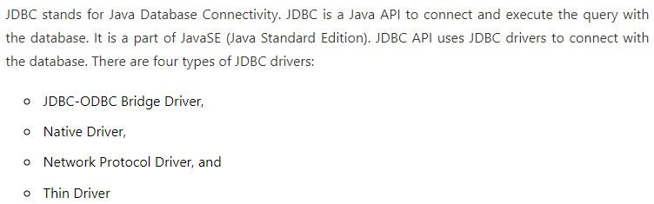
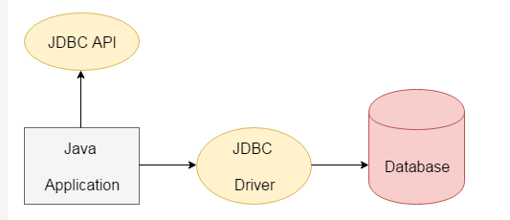
JDBC - Introduction

Slide 4
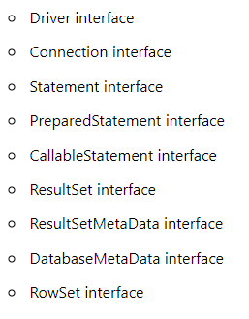
JDBC - Interfaces

Slide 5
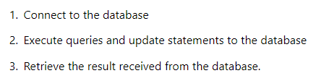
JDBC - Processes

Slide 6
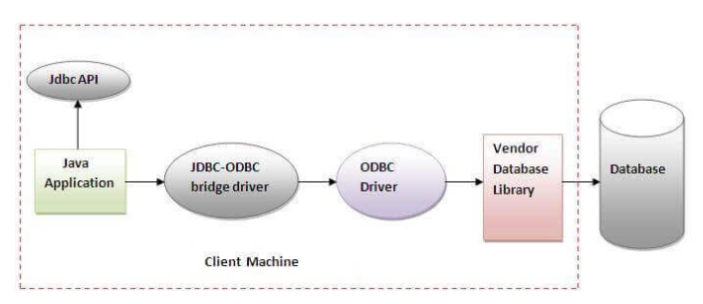
JDBC – Drivers
JDBC driver implementations vary because of the wide variety of operating systems and hardware platforms in which Java operates. Sun has divided the implementation types into four categories.
Type 1: JDBC-ODBC Bridge Driver:
The JDBC-ODBC bridge driver uses ODBC driver to connect to the database. The JDBC-ODBC bridge driver converts JDBC method calls into the ODBC function calls. This is now discouraged because of thin driver.
Advantages:
easy to use.
can be easily connected to any database.
Disadvantages:
Performance degraded because JDBC method call is converted into the ODBC function calls.
The ODBC driver needs to be installed on the client machine.

Slide 7
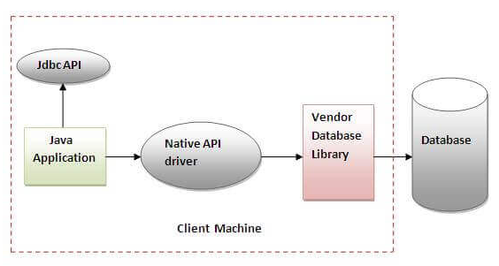
JDBC – Drivers
Type 2: JDBC-Native API
The Native API driver uses the client-side libraries of the database. The driver converts JDBC method calls into native calls of the database API. It is not written entirely in java.
Advantage:
performance upgraded than JDBC-ODBC bridge driver.
Disadvantage:
The Native driver needs to be installed on the each client machine.
The Vendor client library needs to be installed on client machine.

Slide 8
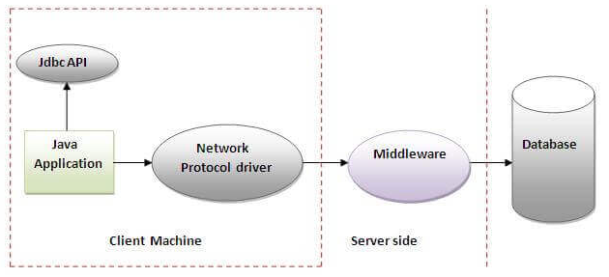
JDBC – Drivers
Type 3: Network Protocol driver
The Network Protocol driver uses middleware (application server) that converts JDBC calls directly or indirectly into the vendor-specific database protocol. It is fully written in java.
Advantage:
No client side library is required because of application server that can perform many tasks like auditing, load balancing, logging etc.
Disadvantages:
Network support is required on client machine.
Requires database-specific coding to be done in the middle tier.
Maintenance of Network Protocol driver becomes costly because it requires database-specific coding to be done in the middle tier.

Slide 9
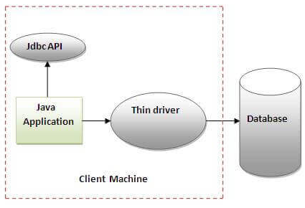
JDBC – Drivers
Type – 4: Thin Driver
The thin driver converts JDBC calls directly into the vendor-specific database protocol. That is why it is known as thin driver. It is fully written in Java language.
Advantage:
Better performance than all other drivers.
No software is required at client side or server side.
Disadvantage:
Drivers depend on the Database.

Slide 10
JDBC – Connection
There are 5 steps to connect any java application with the database using JDBC. These steps are as follows:
Register the Driver class
Create connection
Create statement
Execute queries
Close connection

Slide 11
JDBC – Connection
1) Register the driver class The forName() method of ‘Class’ class is used to register the driver class. This method is used to dynamically load the driver class.
Syntax of forName() method
public static void forName(String className)throws ClassNotFoundException
E.g. – Register with oracle driver
Class.forName("oracle.jdbc.driver.OracleDriver");

Slide 12
JDBC – Oracle Connection
2) Create the connection object - Oracle The getConnection() method of DriverManager class is used to establish connection with the database.
Syntax for getConnection() method
public static Connection getConnection(String url)throws SQLException
public static Connection getConnection(String url,String name,String password) throws SQLException
E.g. – Connect with oracle driver
Connection con=DriverManager.getConnection( "jdbc:oracle:thin:@localhost:1521:xe", "system", "password");
E.g. – Connect with Derby Database
Connection con = DriverManager.getConnection(" jdbc:derby://localhost:1527/A2Database ", “user1", “password1");

Slide 13
JDBC – Create Statement
3) The createStatement() method of Connection interface is used to create statement. The object of statement is responsible to execute queries with the database.
Syntax:
public Statement createStatement()throws SQLException
E.g.:
Statement stmt=con.createStatement();

Slide 14
JDBC – Execute Query
4)The executeQuery() method of Statement interface is used to execute queries to the database. This method returns the object of ResultSet that can be used to get all the records of a table.
Syntax:
public ResultSet executeQuery(String sql)throws SQLException
E.g.:
ResultSet rs=stmt.executeQuery("select * from emp");

Slide 15
JDBC - Close
5) Close the connection Object - By closing connection object statement and ResultSet will be closed automatically. The close() method of Connection interface is used to close the connection.
Syntax:
public void close()throws SQLException
E.g.:
con.close()

Slide 16
JDBC – Connection Interface
A Connection is the session between java application and database. The Connection interface is a factory of Statement, PreparedStatement, and DatabaseMetaData i.e. object of Connection can be used to get the object of Statement and DatabaseMetaData. The Connection interface provide many methods for transaction management like commit(), rollback() etc.
public Statement createStatement(): creates a statement object that can be used to execute SQL queries.
public Statement createStatement (int resultSetType,int resultSetConcurrency): Creates a Statement object that will generate ResultSet objects with the given type and concurrency.
public void setAutoCommit (boolean status): is used to set the commit status. By default it is true.
public void commit (): saves the changes made since the previous commit/rollback permanent.
public void rollback(): Drops all changes made since the previous commit/rollback.
public void close (): closes the connection and Releases a JDBC resources immediately.

Slide 17
JDBC – Statement Interface
The Statement interface provides methods to execute queries with the database. The statement interface is a factory of ResultSet i.e. it provides factory method to get the object of ResultSet.
public boolean execute (String sql): Returns a Boolean value of true if a ResultSet object can be retrieved; otherwise, it returns false. Use this method to execute SQL DDL statements or when need to use truly dynamic SQL.
public int executeUpdate (String sql): Returns the number of rows affected by the execution of the SQL statement. Use this method to execute SQL statements for which expect to get a number of rows affected - for example, an INSERT, UPDATE, or DELETE statement.
public ResultSet executeQuery (String sql): is used to execute SELECT query. It returns the object of ResultSet.

Slide 18
JDBC – Result Set Interface
The object of ResultSet maintains a cursor pointing to a row of a table. Initially, cursor points to before the first row.
Method | Description
public boolean next() | used to move the cursor to the one row next from the current position.
public boolean previous() | used to move the cursor to the one row previous from the current position.
public boolean first() | used to move the cursor to the first row in result set object.
public boolean last() | used to move the cursor to the last row in result set object.
public int getInt(int columnIndex) | used to return the data of specified column index of the current row as int.
public int getInt (String columnName) | used to return the data of specified column name of the current row as int.
public String getString (int columnIndex) | used to return the data of specified column index of the current row as String.
public String getString (String columnName) | used to return the data of specified column name of the current row as String.
public XXX getXXX(int) | Used to return the data of a specified column index. XXX – represents datatype.

Slide 19
JDBC – Prepared Statement
The performance of the application will be faster if you use PreparedStatement interface because query is compiled only once. The prepareStatement() method of Connection interface is used to return the object of PreparedStatement.
Syntax:
public PreparedStatement prepareStatement(String query)throws SQLException{}
E.g.
ps = con.prepareStatement(“insert into employee values(?,?,?,?)”);

Slide 20
JDBC – Prepared Statement
Method | Description
public void setInt (int paramIndex, int value) | sets the integer value to the given parameter index.
public void setString (int paramIndex, String value) | sets the String value to the given parameter index.
public void setFloat (int paramIndex, float value) | sets the float value to the given parameter index.
public void setDouble (int paramIndex, double value) | sets the double value to the given parameter index.
public int executeUpdate() | executes the query. It is used for create, drop, insert, update, delete etc.
public ResultSet executeQuery() | executes the select query. It returns an instance of ResultSet.

Slide 21
JDBC – Prepared Statement Steps
Register –
Class.forName(“oracle.jdbc.driver.OracleDriver”) (not required if you use Derby database)
Establish Connection
Connection conOra = DriverManager.getConenction(“jdbc:oracle:thin:@localhost:1521:xe”,”system”,”vit”)
Connection conDer=DriverManager.getConnection( "jdbc:derby://localhost:1527/testDB1", “user1", "password1");
(note here system, user1 are user name. vit and password1 are passwords which are user defined while creating)

Slide 22
JDBC – Prepared Statement Steps
Statement
st = con.createStatement()
Query Attach
ResultSet rs = st.executeQuery(“select * from mytable”);
int n = st.executeUpdate(“insert into mytable values(101, ’AAAA’, 9876543210) ”);
Prepared Statement
pst = con.prepareStatement(“insert into employee values(?,?,?)”)
pst.setInt(1,101);
Pst.setString(2,”AAAA”);
pst.setLong(3,9876543210);
int n = pst.executeUpdate();

Slide 23
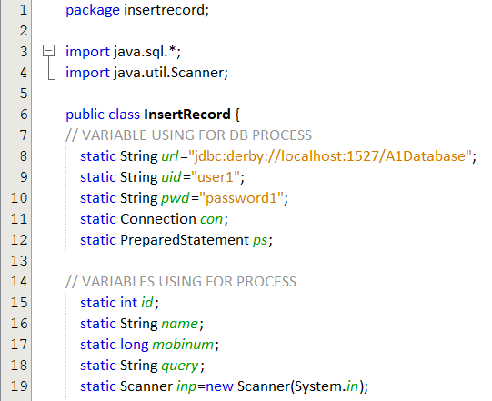
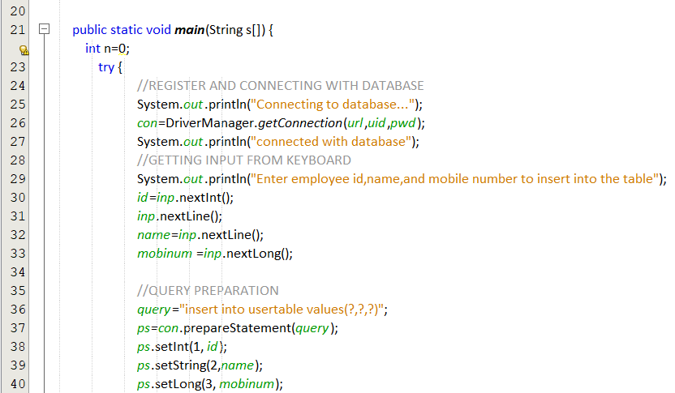
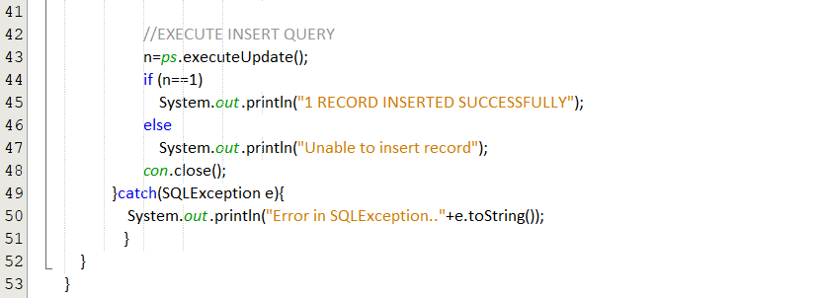
JDBC – Sample Code (Insert)

Slide 24
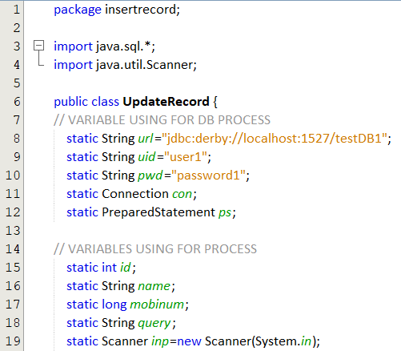
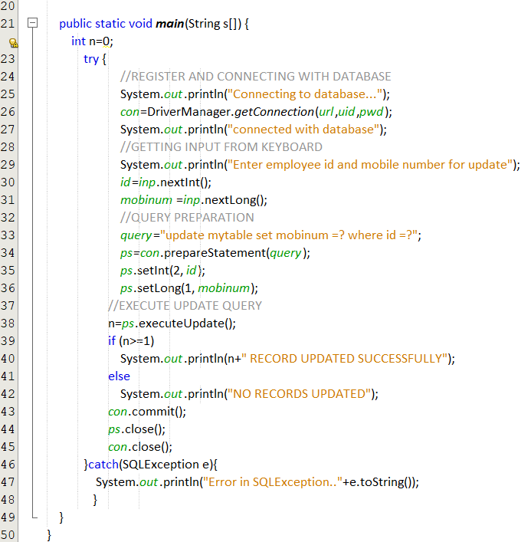
JDBC – Sample Code (Update)

Slide 25
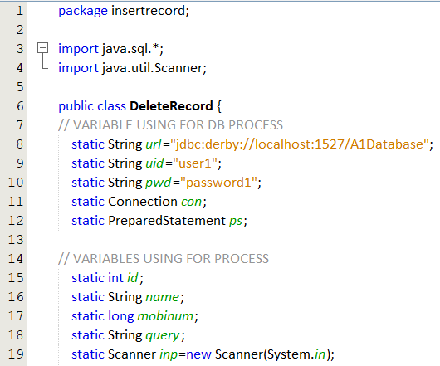
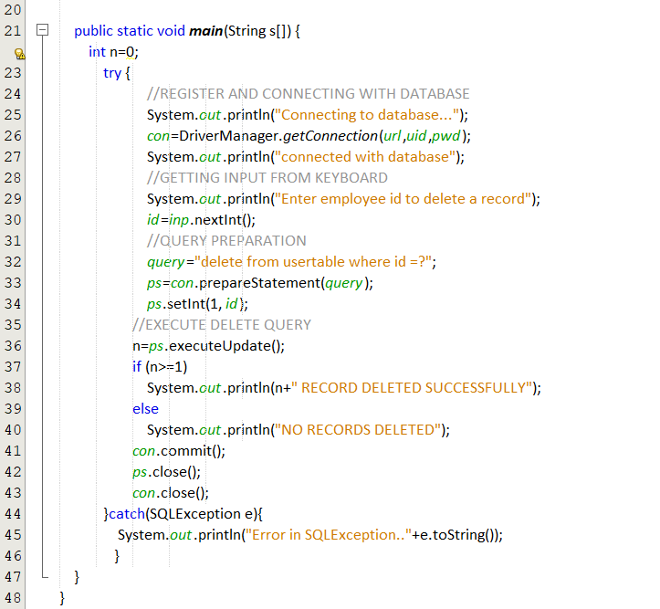
JDBC – Sample Code (Delete)

Slide 26
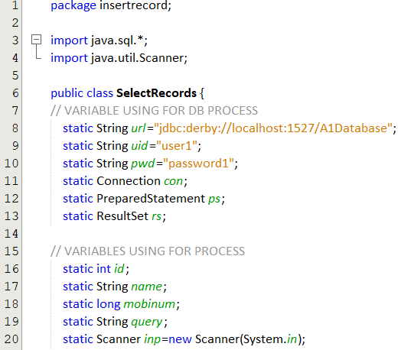
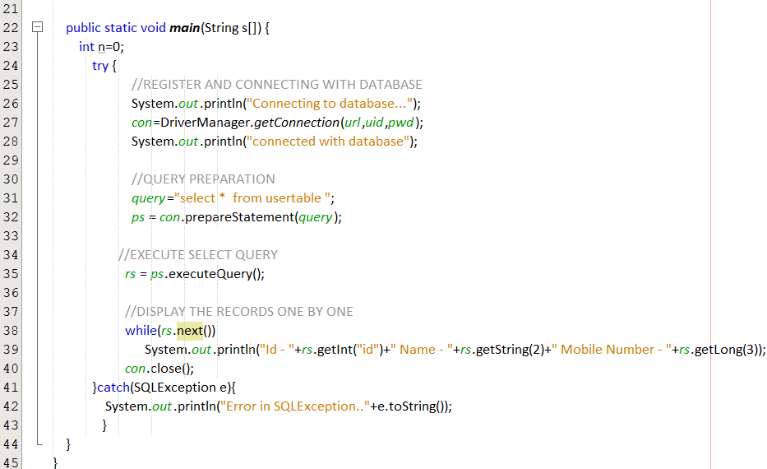
JDBC – Sample Code (Select)

Slide 27
References
Herbert Schildt, The Complete Reference -Java, Tata McGraw-Hill Education, Tenth Edition, 2017.
https://netbeans-ide.informer.com/8.2/ - Netbeans 8 download link
Vijayarani A., AP SITE, VIT, Vellore

